Slide 1
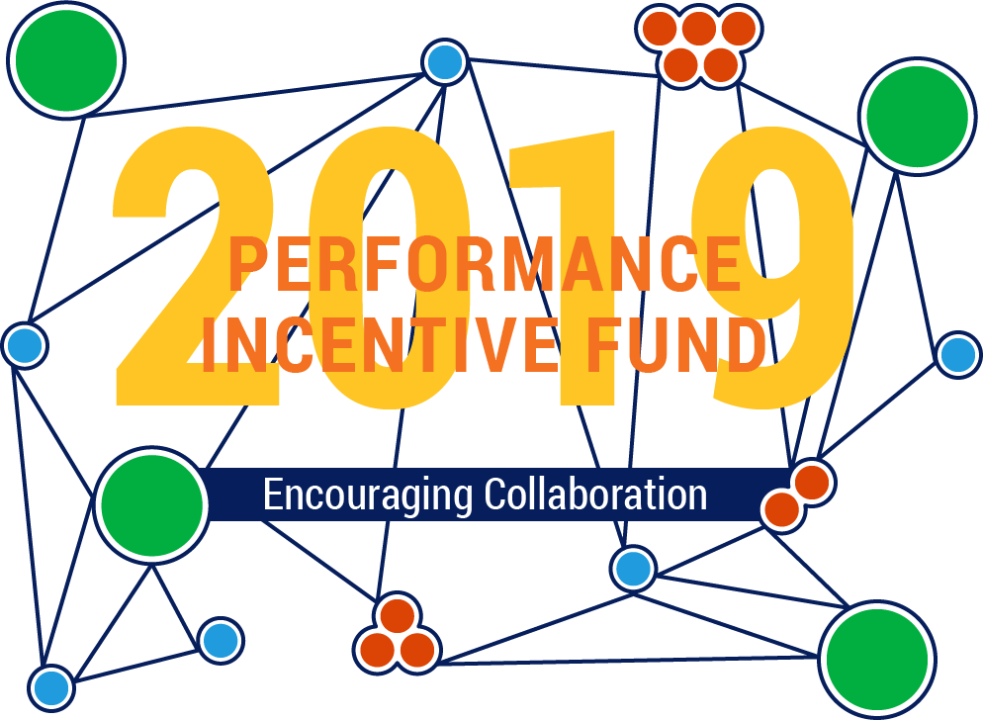
BHE Meeting | December 11, 2018

Slide 2
Presentation Overview
Performance Incentive Fund: Encouraging Collaboration
  Timeline and History of the PIF Appropriation and Grant Activity
  FY19 RFP and Grant Awards
  Consortium projects for FY19 (OER, PLA, and CBE for ECE) system-level metrics for success

Slide 3
Timeline
Performance Incentive Fund: Encouraging Collaboration
FY 2012
PIF created by MA Legislature to provide competitive grants to campuses to make progress on BHE goals
FY 2012–2016
$22.5M in
funding available
through PIF
FY 2016
UMDI PIF Evaluation
FY 2017–2019
$7.85M in
funding available through PIF
Redesign focused on:
1. bringing best practices to scale
2. rigorous evaluation

Slide 4
FY2017–2019 Redesign
Performance Incentive Fund: Encouraging Collaboration
RFP Categories for
Campus & Consortium Grants:
100 Males to College
Competency-based Pathways in ECE
New Approaches to Affordability and Student Success
Co-requisite and Multiple Math Pathways

Slide 5
FY2017–2019 Redesign
Performance Incentive Fund: Encouraging Collaboration
Limited project categories in order to:
  Provide better alignment with specific BHE Goals and ongoing projects
  Scale existing programs grounded in research and
  best practice
  Provide support for projects that could be rigorously evaluated at both campus and system levels by defining a common set of metrics for success
  Focus on sustainability through curricular reform, capacity building, and systemic change
  Promote collaboration and reduce duplication of efforts

Slide 6
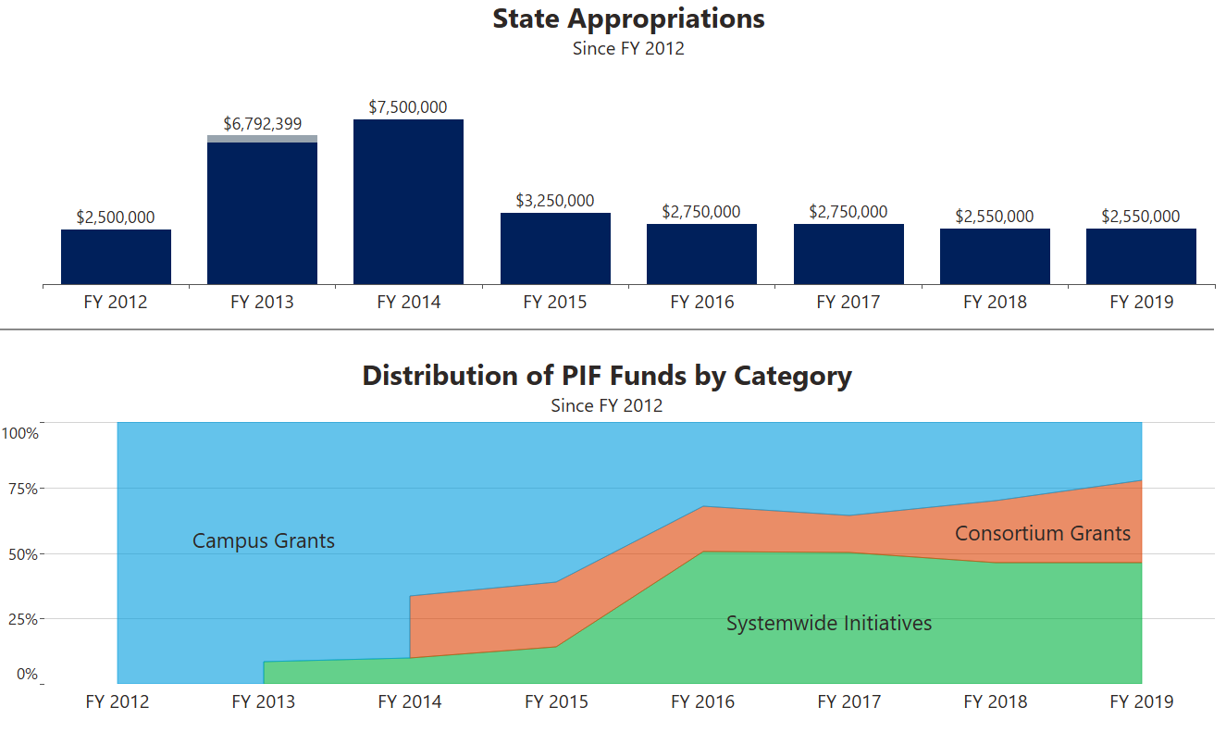
Trend in Appropriation & Grant Activity
Performance Incentive Fund: Encouraging Collaboration

Slide 7
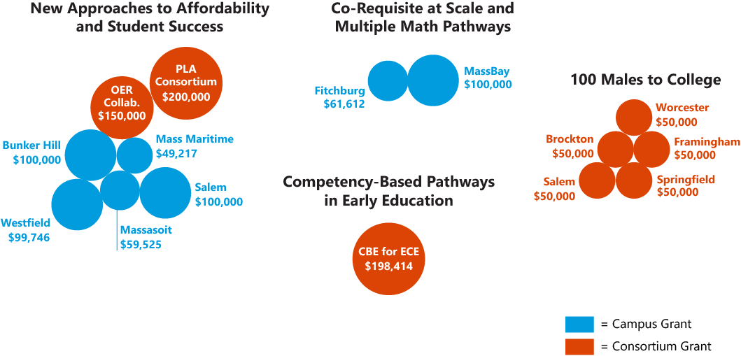
FY19 Campus & Consortium Grants
Performance Incentive Fund: Encouraging Collaboration
Notes:
In addition to these campus and consortium grants, PIF funds six systemwide initiatives in FY19, ranging from $467K for MassTransfer to $26K for Developmental Education.

Slide 8
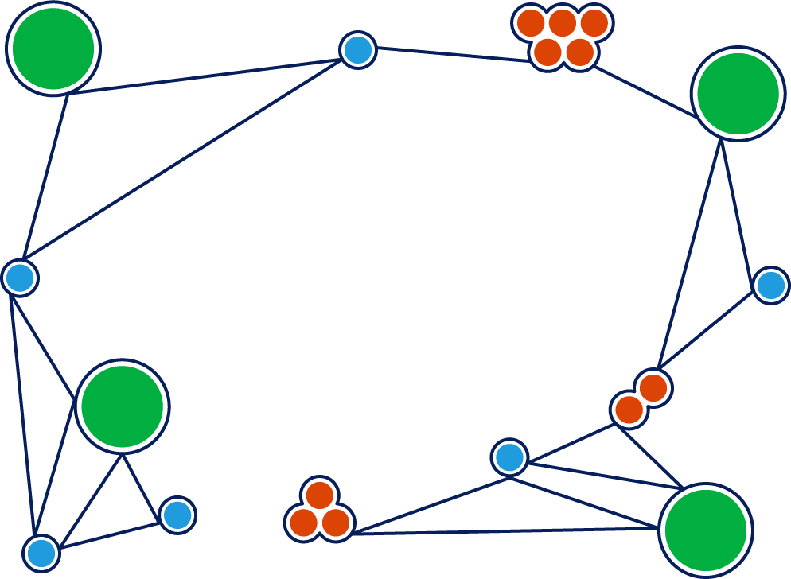
Why OER?
OER offer tremendous cost savings to students, provide equitable access to course materials on day one, improve teaching and learning through the use of open pedagogy, and have a positive impact on student success.

Slide 9
OER Timeline
Performance Incentive Fund: Encouraging Collaboration
2011
Open Education Initiative at UMass Amherst
2016
MA Go Open Project
Spring 2018
SAC Resolution in Support of OER
Creation of MA CC OER Hub: https://www.oercommons.org/hubs/masscc
Fall 2018
Statewide OER Consortium Project funded by PIF
Established OER Working Group

Slide 10
How will we measure success?
Performance Incentive Fund: Encouraging Collaboration
Metrics:
  % increase in the use of OER over baseline established by Working Group in Fall 2018
  Amount of money saved in textbook costs
  % of faculty using OER in their courses
  Success rates of students in courses using OER versus those using traditional textbooks

Slide 11
Massachusetts Open Education: Achieving Access for All
Marilyn Billings, University of Massachusetts Amherst

Slide 12
Goals of Grant
Massachusetts Open Education: Achieving Access for All
Collaborative project focused on building awareness and capacity for open educational resources (OER) across the state
Offers direct benefits to faculty and students at all 29 public higher education institutions in the Commonwealth
Leaders from across the state:
  Community Colleges: Sue, Jody, Karen
  State Universities: Matt, Vicki, Shu
  University of Massachusetts: Marilyn, Jeremy

Slide 13
Statewide Survey of Public
Higher Education
Massachusetts Open Education: Achieving Access for All
Assessing the OER Landscape
Data analysis
Workshop preparation
Notes:
An important outcome of this project is to assess the OER landscape at all public higher education institutions in Massachusetts. By gathering data and information from each college about current OER usage, we will analyze the results to determine regional training needs, assisting the project in achieving its goal of lowering overall costs for students, increasing student and faculty engagement, and ultimately improving college completion rates.

Slide 14
OER Regional Trainings Events
Massachusetts Open Education: Achieving Access for All
Understanding OER (introduction, open licensing, shared examples of OER, and discussion of OER adoption models)
Teaching and Learning with Free and Open Educational Resources (ways to find and use free, CC licensed and public domain content, and incorporating open pedagogy)
The Value of Open (benefits of OER and open pedagogy, examples of OER initiatives, research on OER, and data on the impact of OER)
Implementing and Scaling OER Initiatives (collaboration, starting your initiative, policy, strategies, structure and process, and communicating about OER)
Faculty receive $200 stipend for attending and reviewing an Open Education textbook in their field

Slide 15
Regional Trainings
Massachusetts Open Education: Achieving Access for All
Northern Essex Community College
  February 1, 2019
University of Massachusetts Amherst
  February 8, 2019
Bridgewater State University
  March 12, 2019
Worcester State University
  March 14, 2019

Slide 16
Intensive Day of OER Development
Massachusetts Open Education: Achieving Access for All
Launch Event: Faculty will work in teams to pool resources and experiences to curate, adapt and develop materials for MassTransfer courses
  May 23, 2019 @ NEOER Summit at UMass Amherst
  Limited to 70 faculty members statewide who will receive a $1,000 stipend for their work
  Mass Open Education project will seek applications from community college and state university instructors to work as part of a team to develop OER course materials for aMass Transfer Compact general education course
  More information will be available in January

Slide 17
Massachusetts Open Education Team
Massachusetts Open Education: Achieving Access for All
Matt Bejune, Worcester State
Marilyn Billings, UMass Amherst, PI
Jody Carson, Northern Essex CC
Mary Dixey, Holyoke CC
Vicky Gruzynski, Worcester State
Karen Hines, Holyoke CC
Shu Qian, Worcester State
Jeremy Smith, UMass Amherst
Susan Tashjian, Northern Essex CC
Contact Information: ma-opened-l@library.umass.edu

Slide 18
Why PLA?
“Both Credit for Prior Learning (CPL) and Competency Based Education (CBE) programs appear to boost interest in pursuing coursework among adults who live in the Commonwealth.”
—Maguire Associates
Notes:
In the survey of Massachusetts adults age 25+ who possess a HS diploma but no bachelor’s degree, baseline interest in returning to college was 29%. When asked if they were interested in returning to school if CPL or CBE options were available, interest increased to over 50% for both options.

Slide 19
PLA Timeline
Performance Incentive Fund: Encouraging Collaboration
2016
Prior Learning Initiative: PLA policies inventory, professional development, and best practices
2017
Maguire Associates: Massachusetts DHE: Adult Learner Quantitative Research
Launch of “My Experience Counts” website
2018
PIF Funded MACC PLA Consortium:
All 15 CC’s

Slide 20
How will we measure success?
Performance Incentive Fund: Encouraging Collaboration
Metrics:
  # of credits awarded for PLA systemwide
  # of students who receive credit for PLA
  Amount of money saved based on # of credits awarded
  Retention and graduation rates of students receiving credit for PLA versus those who do not

Slide 21
PLA Consortium
Dr. Karen Hynick, North Shore Community College

Slide 22
Refueling the Race for Post- Secondary Success Study (CAEL)
PLA Consortium

Slide 23
PLA Types of
Competency-Based Education
PLA Consortium
Challenge Exams
Advanced Placement
Industry Recognized Credentials
Microsoft Office Suite
Other Options Include
Portfolio Review
CLEP
DSST/Dantes
BYU
International Baccalaureate
Excelisor Exams
NIMS Certification
Serv Safe Sanitation
CDA
Lean Certified
Departmental Exams
MOOCs
ACE certifications
Military training
Professional Licenses
Thomas Edison Exams

Slide 24
Data: PLA Impacts Student Success
PLA Consortium
CAEL: Refueling the Race to Post-Secondary Education
Students that leverage PLA are 2.5X more likely to complete a college degree
Positive benefits were across all student demographics
Regardless of:
Race
Financial aid status
Age
Type of institution
enrolled in
NSCC Data:
Annually 430 students access PLA
Average 8 credits
Saves an average of $1,600
17% of our graduates last year had leveraged some form of PLA
Roughly 260 courses mapped to a PLA option
Ranked 1st in Massachusetts for serving the adult learner and 16th nationally

Slide 25
Scaling PLA Initiatives from TAACCCT Grant
PLA Consortium
TAACCCT Grant
PIF PLA Consortium Grant
Creation of Statewide PLA Website
Self assessment tool
E-portfolio linked to college CPL specialist
Regional Professional Development of Faculty and Staff
250+ trained
5 regional trainings
Ensuring campus updates to new statewide website
Alignment to common cut scores for challenge exams for Mass Transfer Foundation Courses
Alignment for industry recognized credentials to technical courses
Common policies around CPL
Common pricing of PLA for students
Common coding and transcription of credit
Statewide faculty repository of trained portfolio reviewers to compete with CAEL

Slide 26
Further Developing MA
CC Consortium Development
PLA Consortium
Common coding
Common marketing plan
Partner with DHE for PLA alignment with MassTransfer (cut scores)
600,000 Massachusetts residents with some college but no degree to comeback and finish their degree through CPL and community college sector
Application for ECCF Funds 75,000 over 2 years
Consortium of the 15 Community Colleges
most effective catalyst to accomplishing next steps to enhance each college enrollment and most cost efficient mechanism to achieve individual college ROI/surplus.
HBS Study 2015

Slide 27
Why CBE for Early Childhood Educators?
Competency-Based Education for Early Childhood Educators supports campus efforts to adapt academic programming to students’ mastery
of key learning objectives
for early childhood
(birth–age 8) educators

Slide 28
Why CBE for Early Childhood Educators?
Performance Incentive Fund: Encouraging Collaboration
Aligned with BHE Goals of Developing Better Integration with P–12, Incubating Innovation
Continues collaborative work between DHE/EEC
designed to address educational opportunity gaps where they are constructed—in early childhood
  Creates a foundational CBE ECE certificate program and provides a pathway to Director 2 EEC Certification
  Maximizes resources and reduces duplication of efforts

Slide 29


CBE for ECE Timeline
Performance Incentive Fund: Encouraging Collaboration
2010–2015
● Cross Agency work to Advance certificate and degree attainment
● Report endorsed by DHE, EEC, ESE Commissioners
2016–2017
● Launch of PIF project to develop faculty capacity
● ECE Mass Transfer Pathways
● Explore Early EdU training to credit/ competency bearing
2018–2019
● Focus on accreditation issues
● Closer collaboration with EEC and employers
● Targeted strategy to address
wage issue
2017–2018
● Professional development & resources offered to campuses—faculty trainings, accessibility tutorial, accreditation webinar
● Deliverables completed—faculty-written OER textbook, crosswalk standards and courses, employer needs assessment

Slide 30
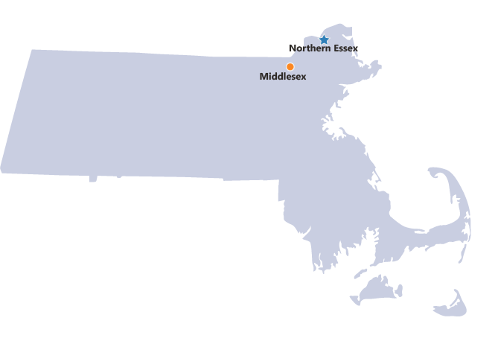
Expansion of the Initiative
Performance Incentive Fund: Encouraging Collaboration
Scaling Up: FY 2017 Participating Campuses

Slide 31
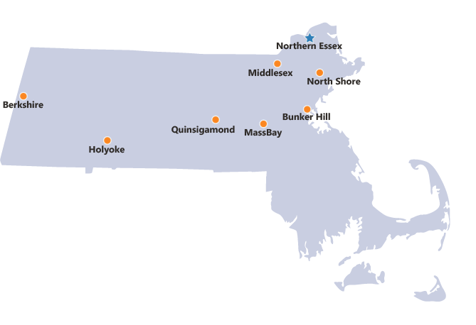
Expansion of the Initiative
Performance Incentive Fund: Encouraging Collaboration
Scaling Up: FY 2019 Participating Campuses

Slide 32
How will we measure success?
Performance Incentive Fund: Encouraging Collaboration
Metrics:
  Increase degree completion for adult learners through alt. delivery systems
  Broaden early educator access to certificates and degree programs
  Increase number of faculty who are able to describe national and local CBE models
  Expand model to engage all 15 community colleges

Slide 33
Competency-Based Pathways in
Early Education and Care Consortium
Kimberly Burns, Dean of Academic Innovations and Dean of Professional Development, Northern Essex Community College

Slide 34
Consortium Community Colleges
Competency-Based Pathways in Early Education and Care Consortium
Berkshire
Bunker Hill
Holyoke
MassBay
Middlesex
North Shore
Northern Essex
Quinsigamond

Slide 35

Power of Partnerships
Competency-Based Pathways in Early Education and Care Consortium
DHE
Community College Faculty
EEC
Notes:
Power of partnerships
Innovation seed money
Innovative aspects of this project
Relationship to Big 3
Alignment with other DHE initiatives
OER

Slide 36
FY18 Grant Outcomes
Competency-Based Pathways in Early Education and Care Consortium
Increased faculty knowledge of CBE
New CBE credential
New Child Growth and Development open textbook
Review & pilot of EarlyEdu Alliance courses
Notes:
Faculty increased their knowledge of competency-based education by creating competency maps and adapting lessons and assignments to CBE delivery.
NECC created a new certificate for practitioners to become certified at the Director II level. NECC adapted 2 courses in the certificate to CBE delivery.
Faculty wrote an open textbook for a Child Growth & Development course.
Faculty reviewed EarlyEdu Alliance courses and determined they can supplement associate degree coursework. Professor Tricia Kiefer of Holyoke Community College piloted the use of materials in her course this semester.

Slide 37
FY18 Grant Outcomes
Competency-Based Pathways in Early Education and Care Consortium
Crosswalk of MassTransfer ECE Foundational Course Outcomes
Environmental scan of employer needs & readiness for CBE
Open access tools to assist campuses in rolling out CBE academic programs
Notes:
Faculty created a crosswalk of MassTransfer ECE Foundational Course Outcomes.
Kris Clerkin of Volta Learning Group conducted an environmental scan of the field and employers’ readiness to embrace CBE.
Several open access tools were built to assist campuses in rolling out CBE academic programs:
CBE Accreditation and Regulations Webinar
Online CBE 101 training course
Online Accessible Course Content Tutorial

Slide 38
FY19 Planned Activities
Competency-Based Pathways in Early Education and Care Consortium
EEC Career Pathways, Core Knowledge & Competencies review
Competency alignment
CBE pathway development
Competency-based alternative credential
OER and EarlyEdu Alliance
Employer engagement
Notes:
EEC Career Pathways Review
Competency alignment
New EEC Core Knowledge & Competencies
New NAEYC professional standards
Associate degree programs & certificates
MassTransfer Foundational Courses
CBE pathway development
Competency-based alternative credential
OER and EarlyEdu Alliance
Employer engagement

Slide 39


Early evidence
Competency-Based Pathways in Early Education and Care Consortium
ECE 101 Intro to Early Childhood Education
1st CBE ECE course
Fall 2018
16 student educators
Free; tuition funded by EEC R3P
OER – no textbook cost
Improved mastery of content
Increased success of
  linguistically diverse students

Slide 40
Vision
Competency-Based Pathways in Early Education and Care Consortium
Community colleges contribute viable solutions to the current early educator crisis AND builds sustainable on-ramp for future
Early educators have greater access to higher learning through stacked, competency-based credentials
New opportunities for linguistically and racially diverse practitioners
Partnerships with employers
Notes:
The Early Childhood Education workforce matters to the economic future of Massachusetts because the Early Childhood industry makes a great deal of other work possible in multiple other industries,…A lot of employees are able to go to work because of the child care industry. Moreover, I would hypothesize the following: Any state that develops a first-world early childhood education system will go a long way toward mitigating the economic issues associated with impending demographic declines. The early childhood education workforce carries water for other industries in the form of low wages. We need a better strategy.
The early childhood education industry represents the largest workforce in all of the education sectors, with the added assets of being the most linguistically and racially diverse, and the best match for our youngest citizens…but this workforce has the least access to higher education and professional development opportunities. Clearly, a competency based education pathway for this workforce makes for a compelling innovation that addresses a significant problem.

Slide 41
Questions & Discussion

